Slide 1
Using Adaptive Cards Designer control from the PnP control gallery in SPFx solutions
Fabio Franzini – CEO Apvee Solutions – Microsoft MVP

Slide 2
Agenda
Recap of Adaptive Card Host
Introduction to the Adaptive Card Designer control, how it was implemented and how to use it in SPFx
Demo
Next Steps
References

Slide 3
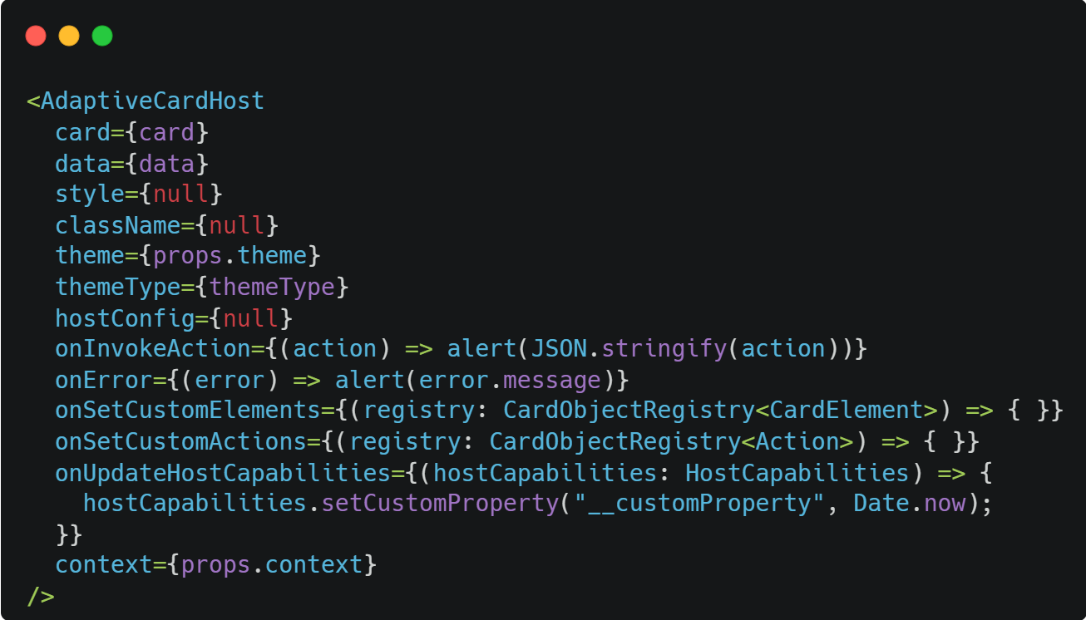
Recap of Adaptive Card Host
React Control that render an Adaptive Card using the SDK
Using a brand-new elements that use the Fluent UI Theme both for SharePoint and Microsoft Teams
Auto apply the AC Template if data object is passed to the control
Callbacks to intercept Actions and Errors
Callbacks to set Custom Elements and Custom Actions
Callback to set custom Host Capability properties

Slide 4
Recap of Adaptive Card Host: Same code, different scenarios
SharePoint - SPFx Web Part
Teams Tab - SPFx Web Part

Slide 5

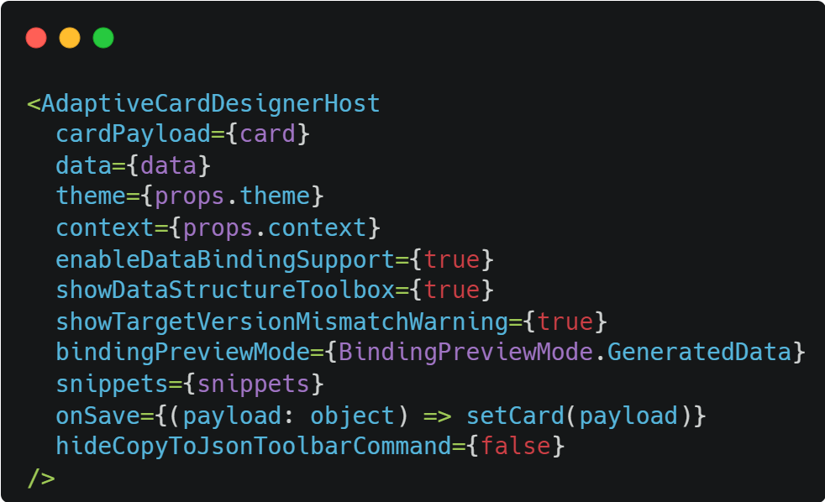
Introduction to the Adaptive Card Designer control
React Control that render an Adaptive Card Designer using the SDK
Open the Designer as a Fluent UI Panel
Fix all problems on hosting the Designer in React controls and in SPFx
Use all Elements and Actions from the Adaptive Card Host control
Same “Data Structure” of the Adaptive Card Host control
Easy to use!
Possibility to add snippets of cards
Available from the next version of the PnP Reusable React controls library

Slide 6
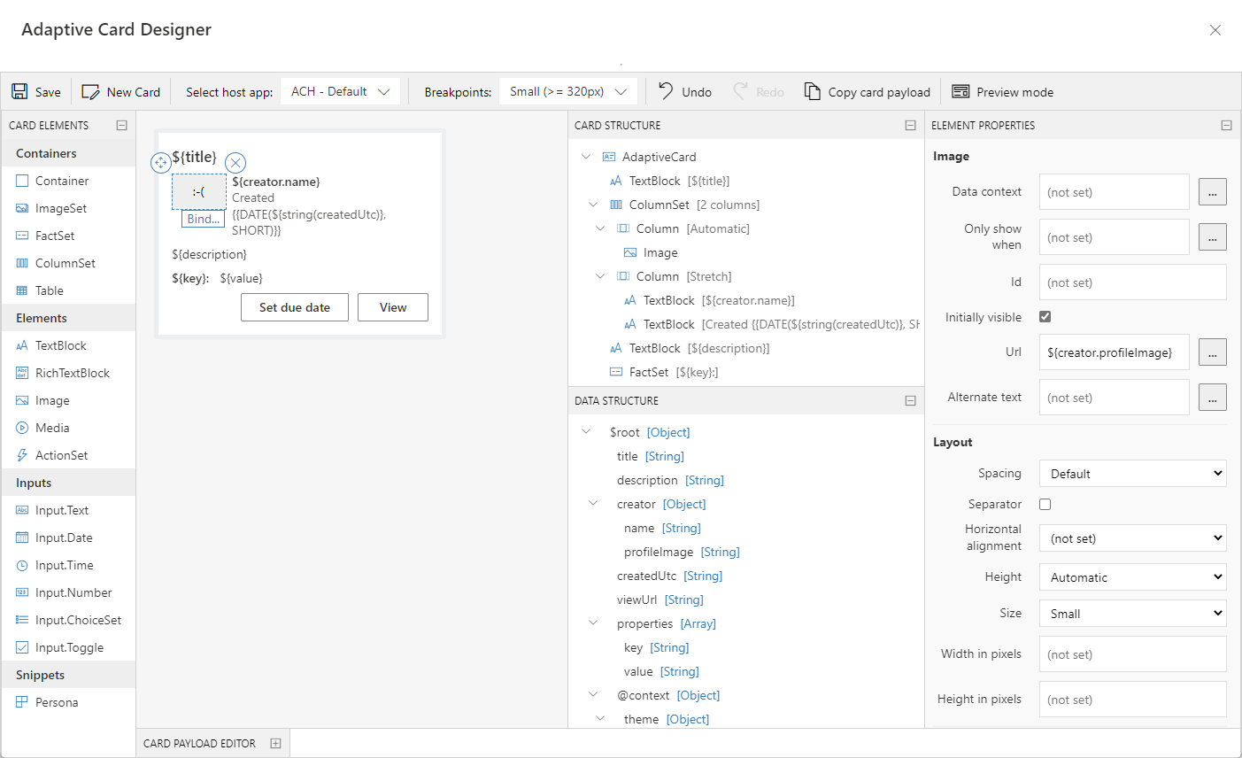
Introduction to the Adaptive Card Designer control

Slide 7
DEMO & CODE

Slide 8
Next Steps
Implement the Adaptive Card Host component for the PnP Reusable React Controls Library (Available from version 3.6.0)
Implement the Adaptive Card Designer component for the PnP Reusable React Controls Library (Available from the next version of the library)
Create a set of new Adaptive Cards Elements (targeted only for JS SDK)
Maybe using Fluent UI React
Maybe using Fluent UI Web Components
Maybe using MGT (Thanks to João Mendes)

Slide 9

About Me
I’m CEO at Apvee Solutions, startup focused on building solutions on top of Microsoft 365 ecosystem.
I'm a Microsoft MVP in Office Development and Business Applications categories.
Mail: fabio@apvee.com
Twitter: @franzinifabio
LinkedIn: www.linkedin.com/in/fabiofranzini
GitHub: https://github.com/fabiofranzini

Slide 10
References
https://adaptivecards.io/
https://pnp.github.io/sp-dev-fx-controls-react/controls/AdaptiveCardHost/
https://github.com/pnp/sp-dev-fx-webparts/tree/main/samples/react-adaptive-card-host-control

Slide 11
Thank you!
Fabio Franzini – CEO Apvee Solutions – Microsoft MVP

